Slide 1
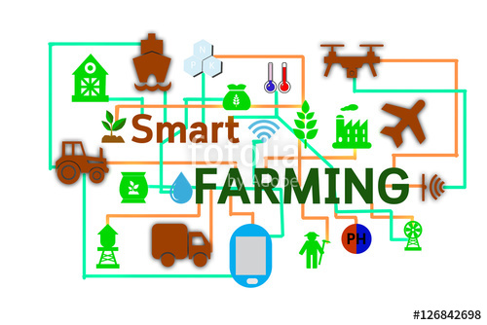
FIRMA APP
-------An innovative step towards agriculture

Slide 2
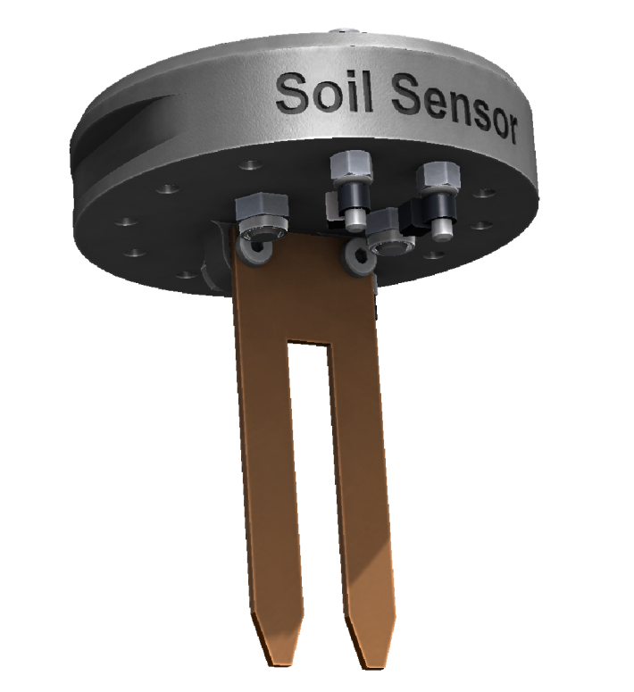
THEME
The theme basically deals with the minimization of human efforts by autonomous methods which are way more accurate and efficient.
So there is a need for autonomous and time saving technology in agriculture to have efficient farm management.

Slide 3
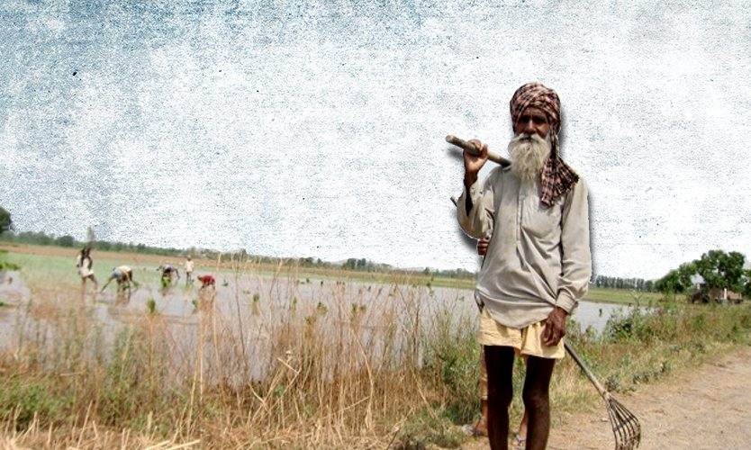
PROBLEM STATEMENT
In our country farmers face a lot of issues due to loss of crops, water scarcity, lack of knowledge, climatic changes, excess use of fertilizer and sometimes due to lack of proper funds.
Through this project we are going to solve all the major issues farmers will face and provide an alternative for them.

Slide 4
SOLUTIONS
Through this project we are going to implement the following things
Develop a tool in the app so that it responds to all climatic changes using sensors and warn the farmers.
An agriculture inclusive feature through which the details of the field can be passed to the whole agriculture offices so that all the details and things which farmers don’t know about the damage can be made to know and get alerted from the office
We can develop a tool inside the app in which all yojanas or mutual benefits subscribe for farmers can be updated so that farmers can get details of all of the benefits he could apply for.
A tool can be developed which record all the amount spend by the farmers and all the utilities he needs so that this information can be shared by the govt. and refunds can be received

Slide 5
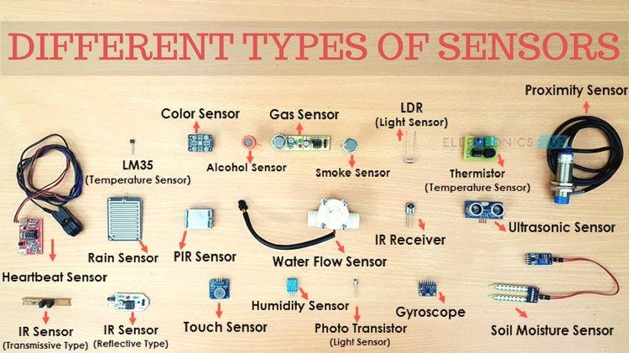

Slide 6
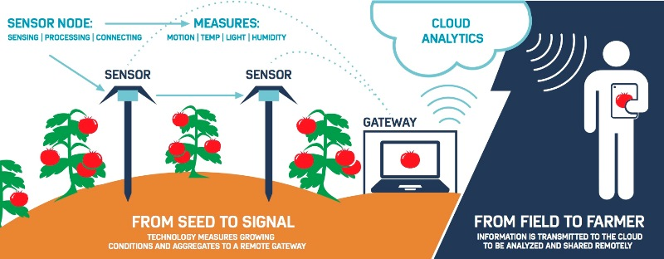

Slide 7
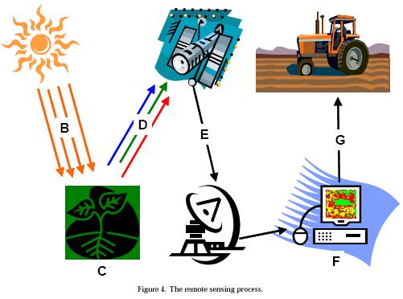

Slide 8
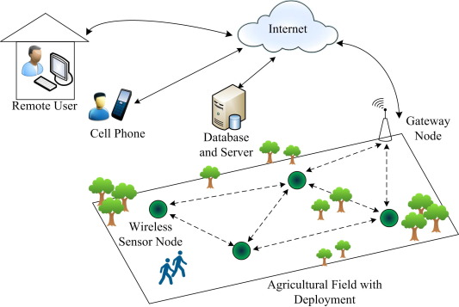

Slide 9
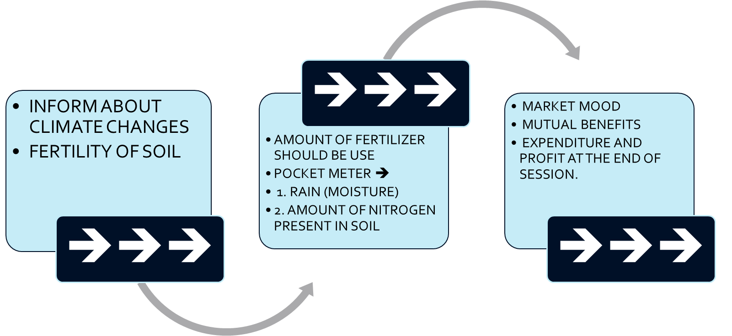
FARM APP BENEFITS

Slide 10
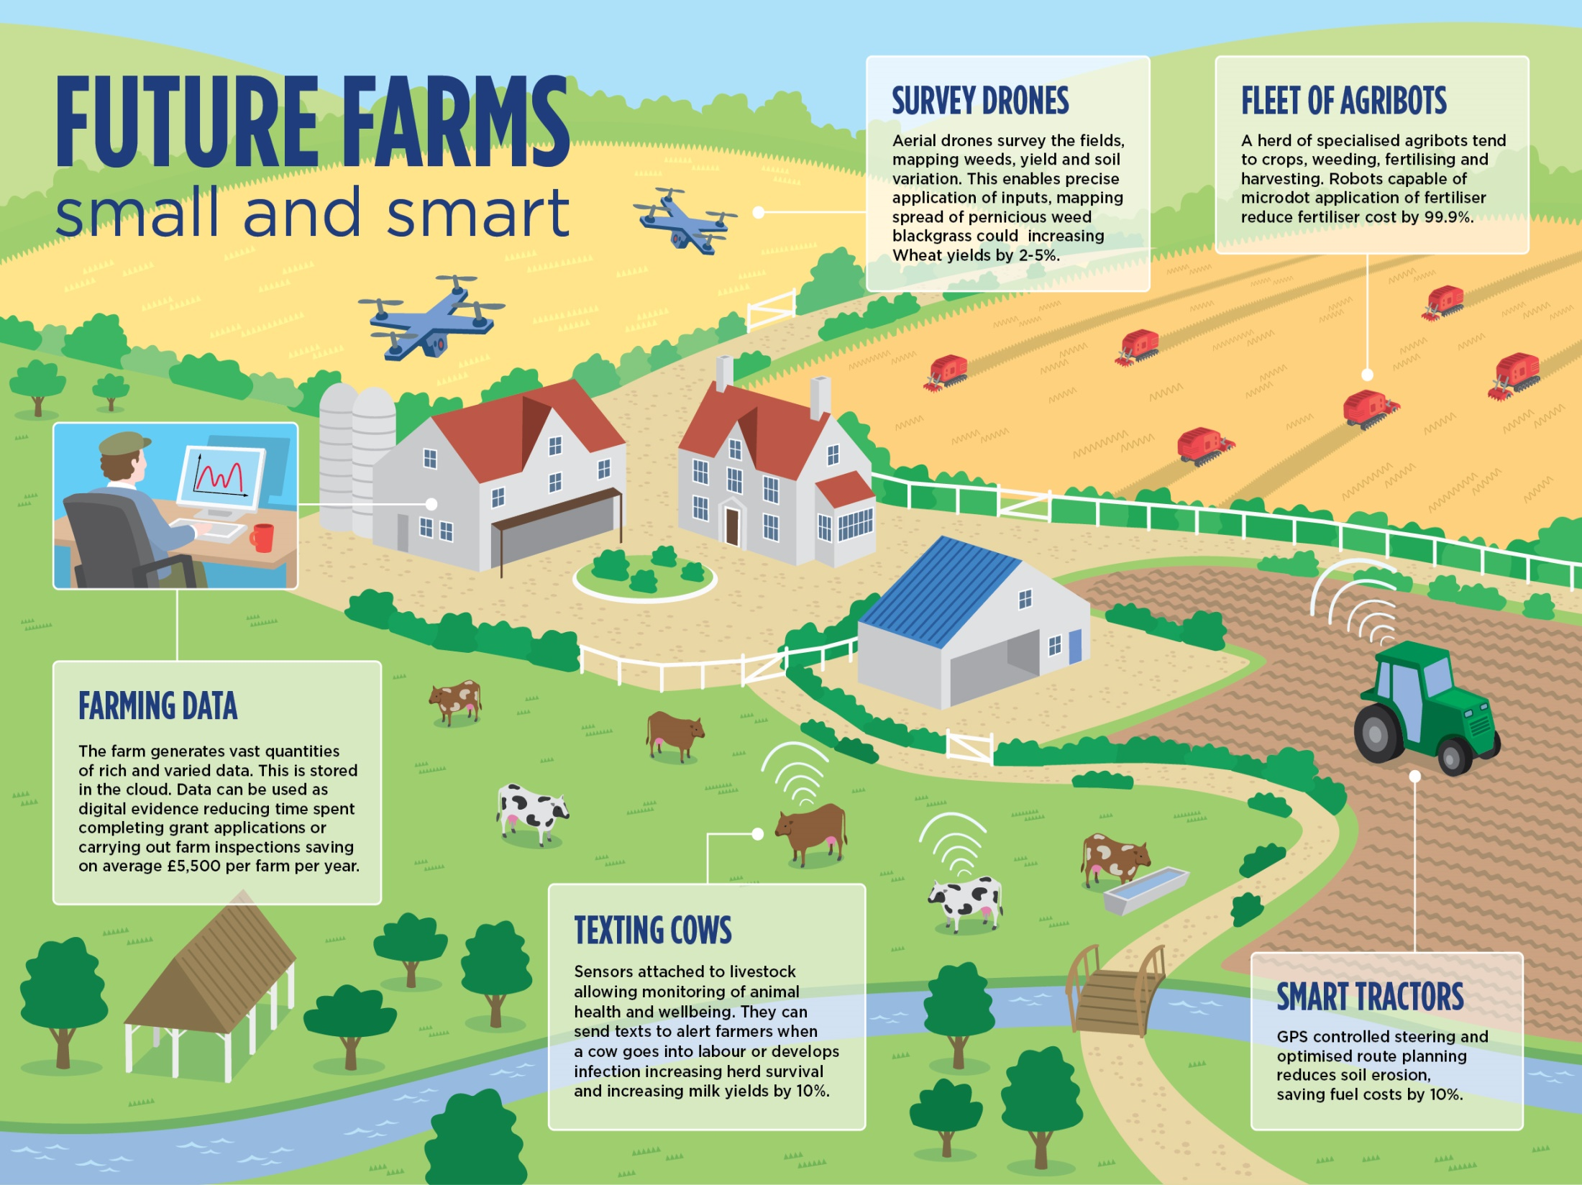

Slide 11
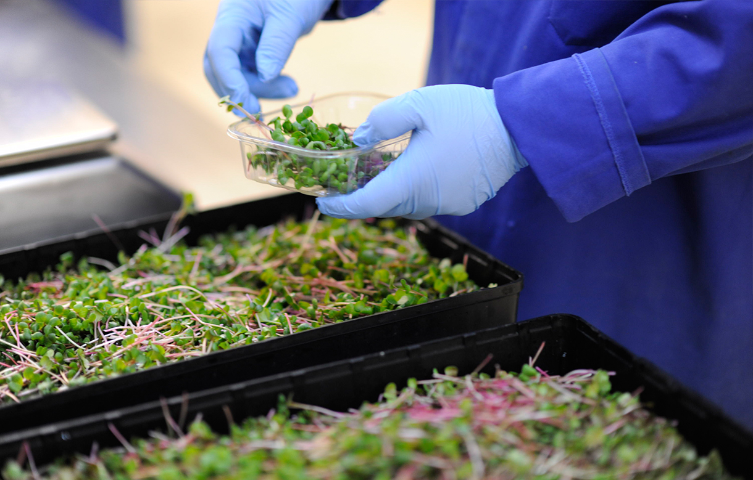
THANK YOU

